Slide 1
TITANIC SURVIVAL ANALYSIS
Group:18
Team Members:
Ankit Prakash
Aniket Kumar
Anagh Bhattacharya
Amit Raj Singh
Amit Rai
Amit Kumar

Slide 2
INTRODUCTION
Python: Python is a clear and powerful object-oriented programming language which is platform independent and is one of the most popular language for machine learning and data analysis
Python Features:
Comes with a large standard library that support many common programming task such as connecting to web servers, searching text with regular expressions, reading and modifying files.
Runs anywhere, including Mac OS X, Windows, Linux and Unix with unofficial builds also available for Android and iOS.
Uses an elegant syntax, making the programs we write easier to read.
Python support object-oriented programming with classes and multiple inheritance
Data types are strongly and dynamically typed. Mixed incompatible type (e.g. Attempting to add a string and a number) causes an exception to be raised, so errors are caught sooner.

Slide 3
INTRODUCTION TO MACHINE LEARNINIG
Machine learning is an application of artificial intelligence (AI) that provides system the ability to automatically learn and improve from experience without being explicitly programmed. Machine learning focuses on the development of computer programs that can access data and use it learn for themselves
The primary aim is to allow the computers learn automatically without human intervention or assistance and adjust actions accordingly.
Applications:
• Handwriting Recognition
• Medical Diagnosis
• Email Spam Filtering
• Recommendation Engine
• Face Detection
• Fraud Detection

Slide 4
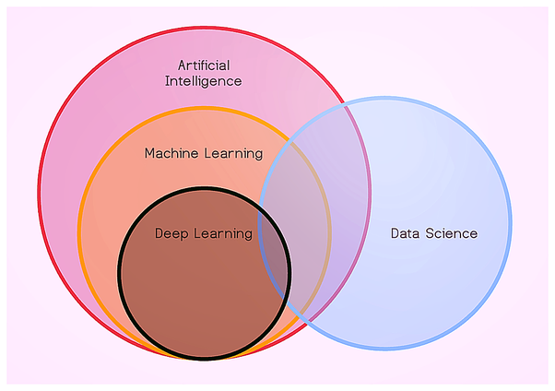
DATA SCIENCE
Data science is an inter-disciplinary field that uses scientific methods, processes,
algorithms and systems to extract knowledge and insights from structured and
unstructured data.

Slide 5
INTRODUCTION TO NumPy AND Pandas
NumPy:
• NumPy (Numeric Python) is a linear algebra library for python.
• NumPy enriches the programming language Python with powerful data structure for efficient computation of multi-dimensional arrays and matrices.
• The number of dimensions is the rank of the array; the shape of an array is a tuple of integers giving the size of the array along each dimension.
Pandas:
• Pandas is the most popular python library that is used for data analysis.
• It provides highly optimized performance with back-end source code is purely written in C or Python.
• We analysis data in pandas with:
Series (1-d array)
Data Frame (2-d array)

Slide 6
Titanic Survival Data
“Titanic Survival Prediction” problem: We are asked to analyze the passenger travelling survived or not during the tragedy .
Aim: Our aim was to try to find and analyze which person survived and to show the different graphs of the tragedy .

Slide 7
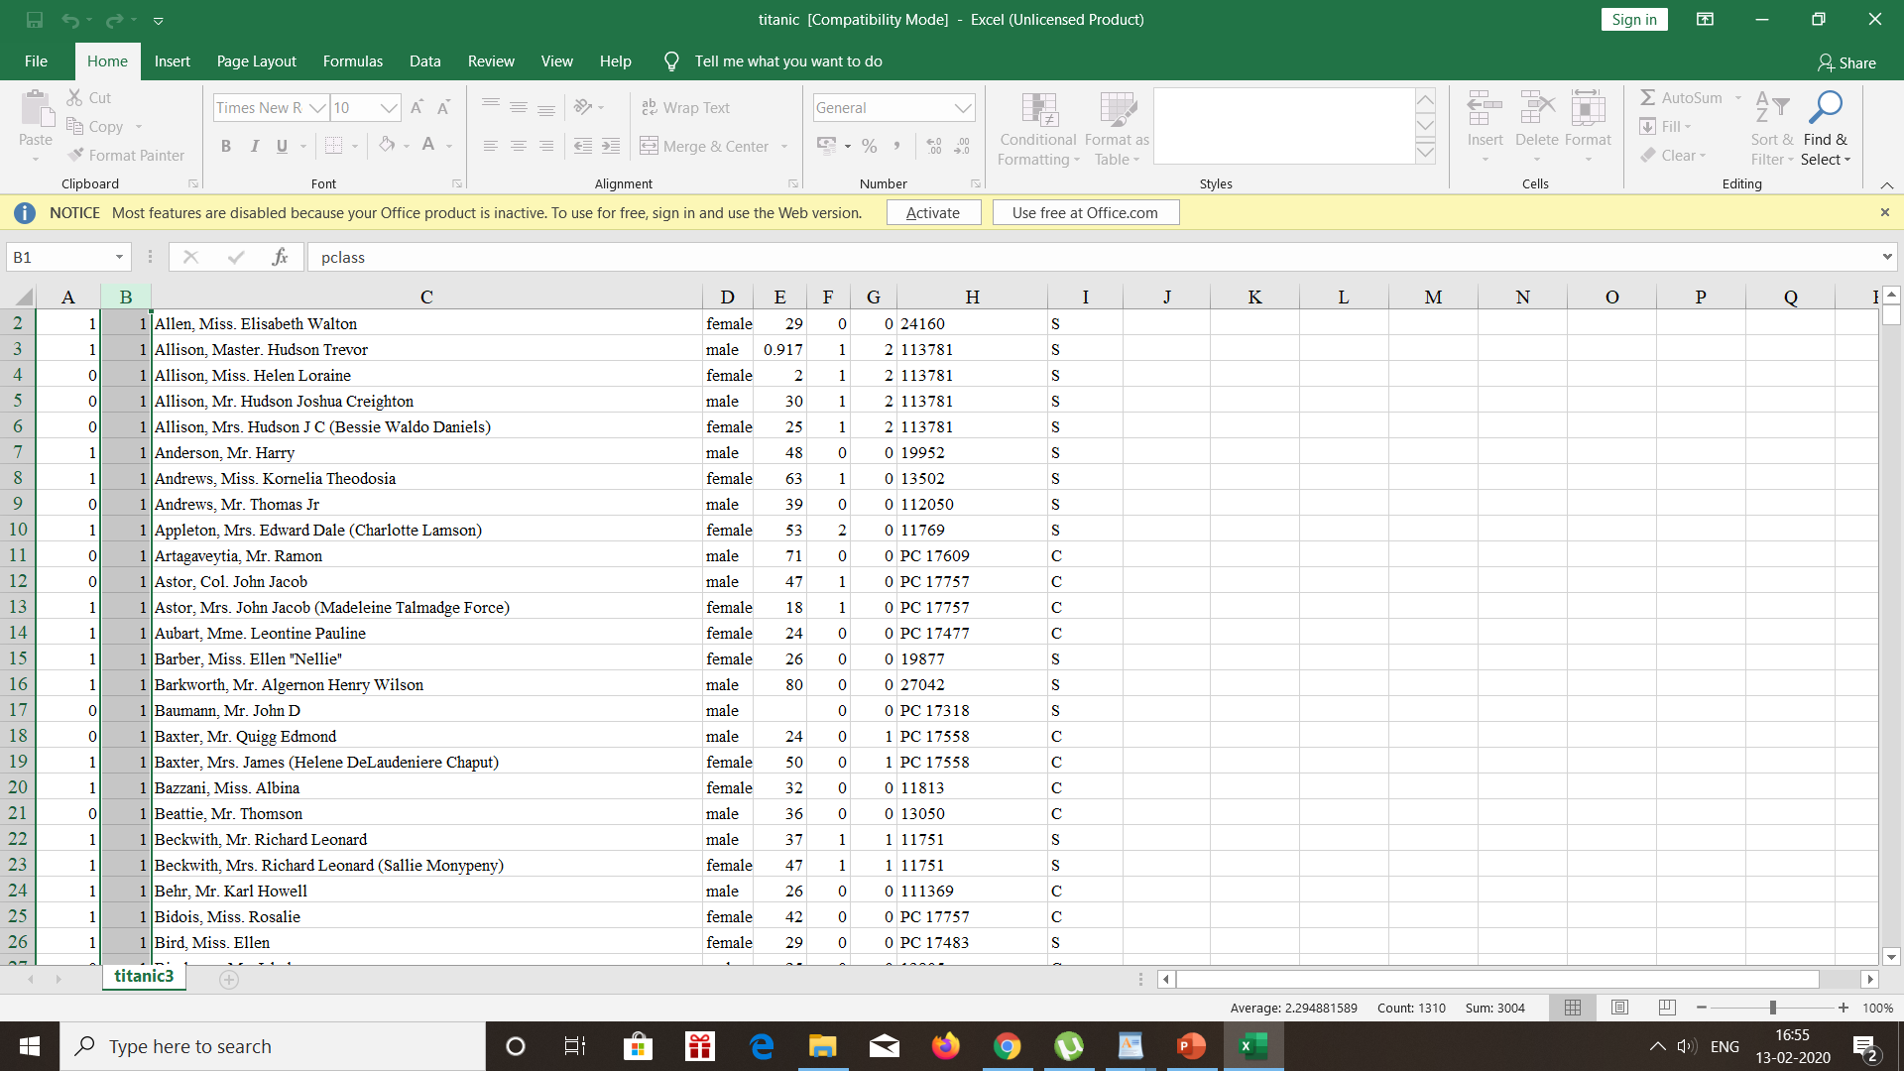
Displaying The File

Slide 8
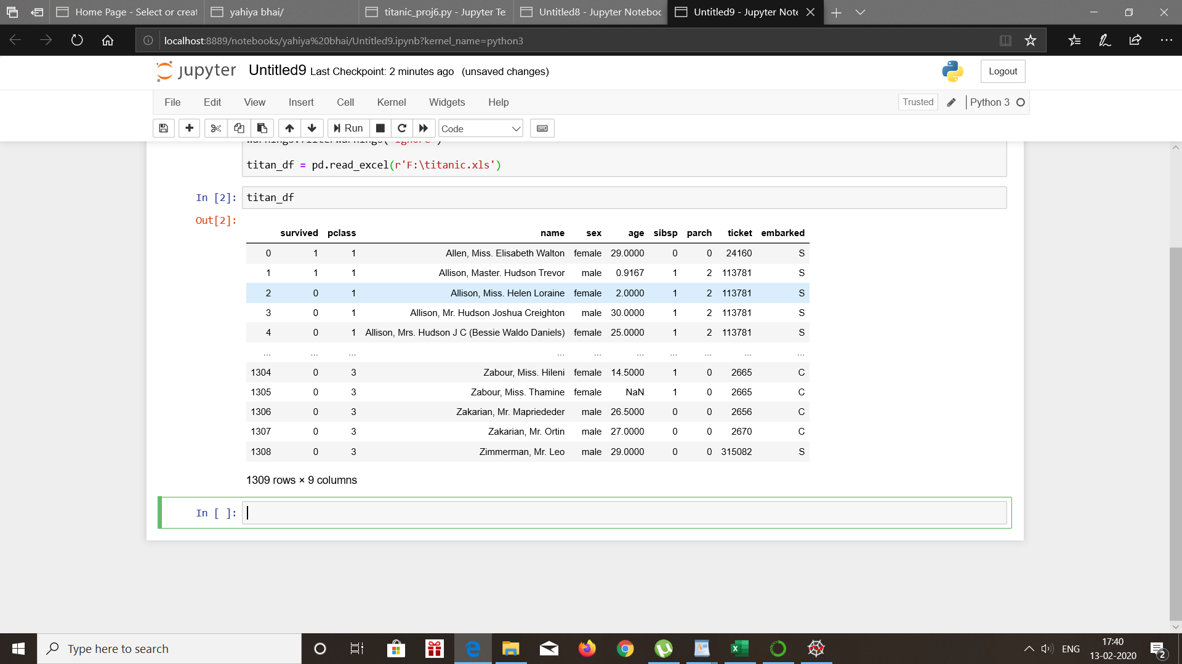
Convert Titanic excel on Pandas DF

Slide 9
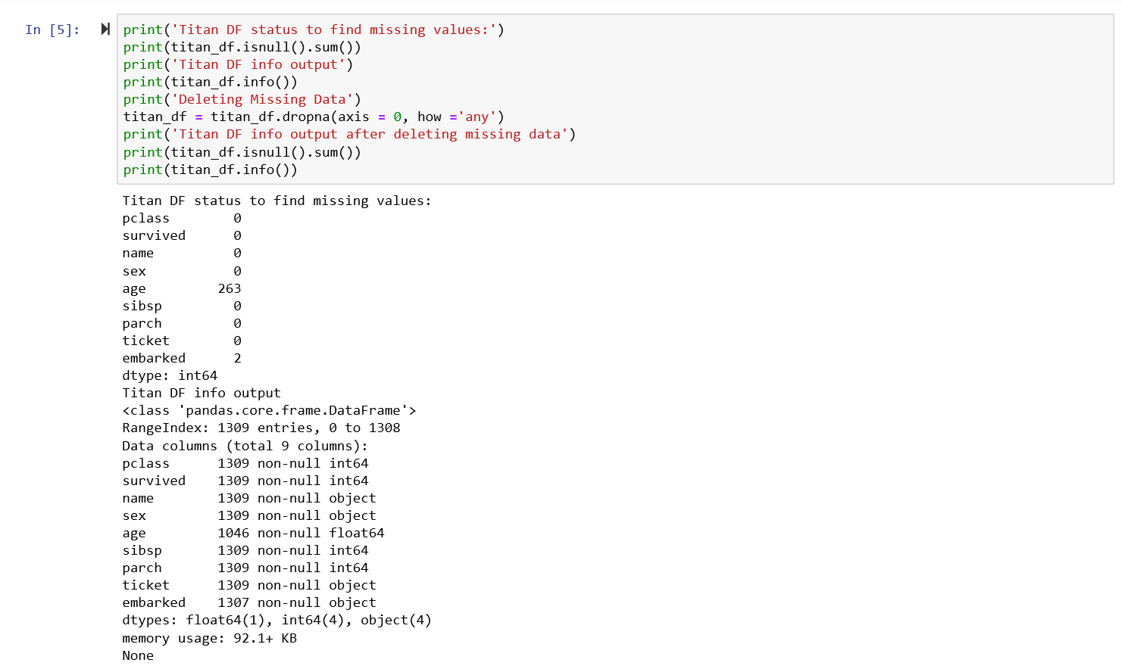
Data Wrangling

Slide 10
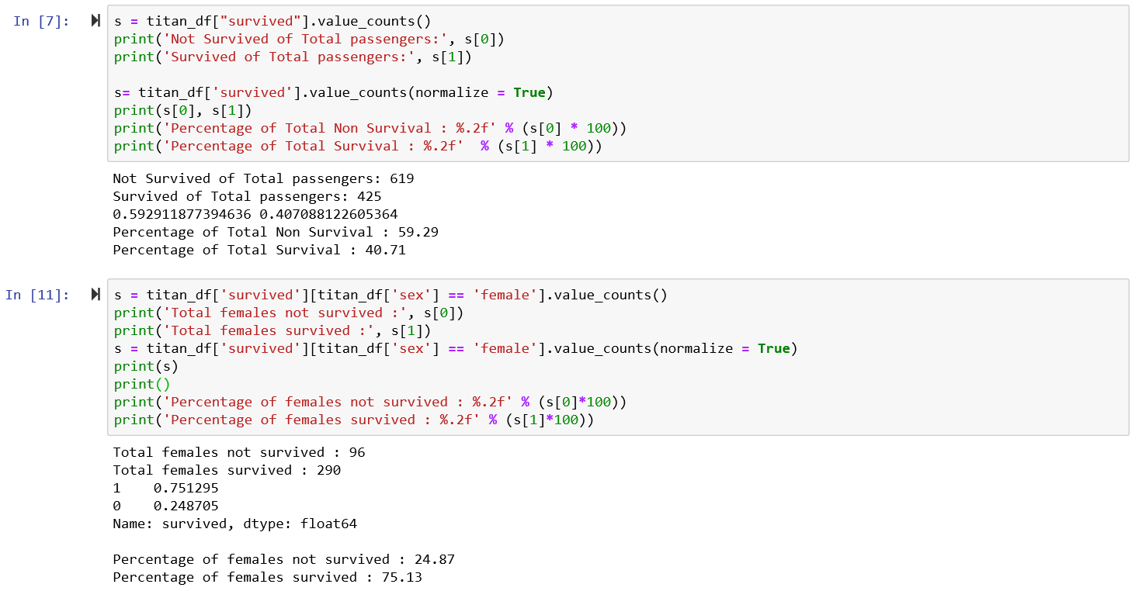
Survived v/s Non Survived

Slide 11
Female Survived v/s Non-Survived

Slide 12
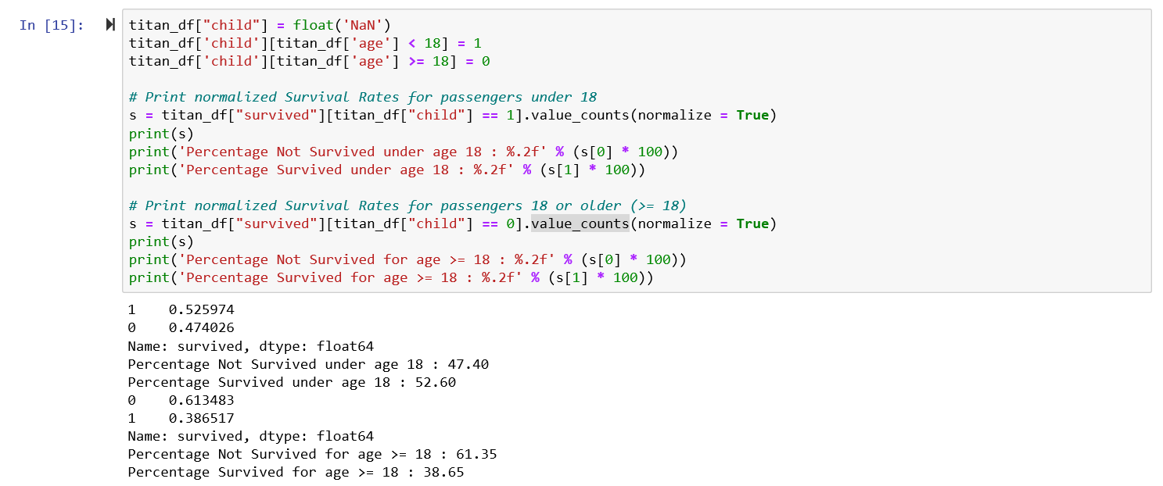
Normalized survival rates for Passengers under 18 and above 18

Slide 13
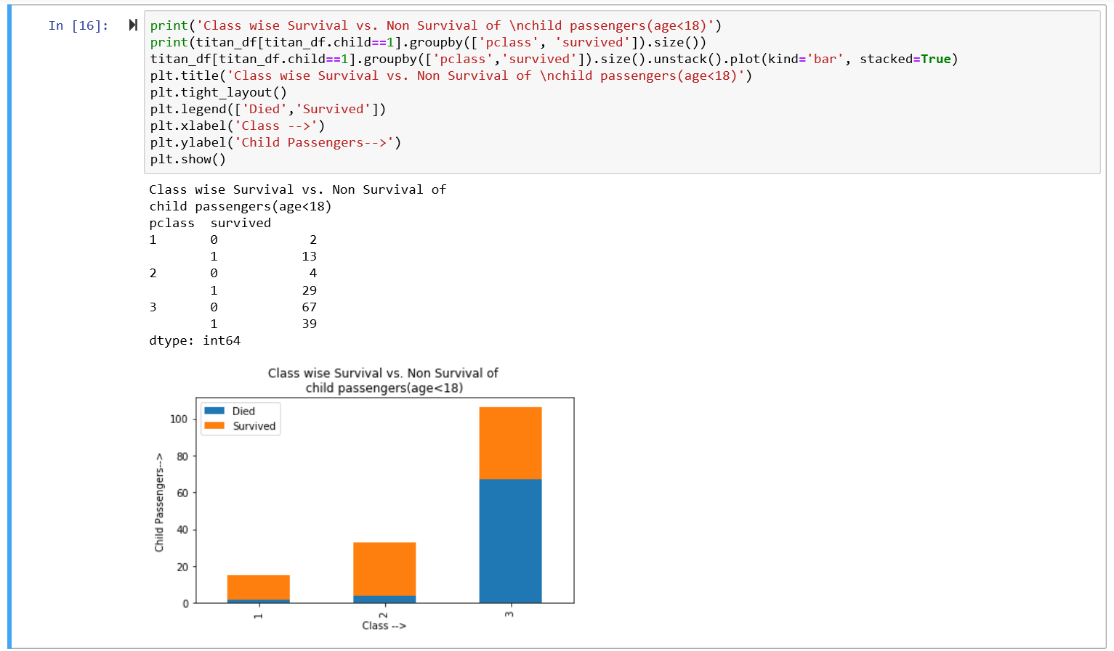
Class wise Survival v/s Non Survival of Child Passengers

Slide 14
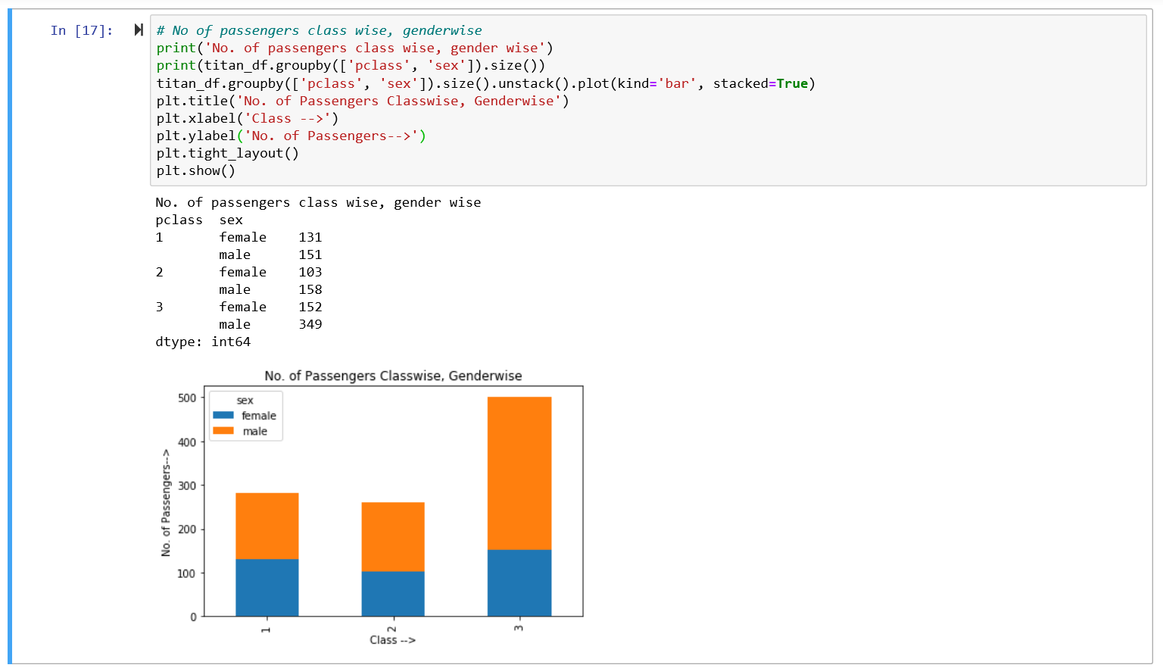
Number of Passengers Class wise and Gender wise

Slide 15
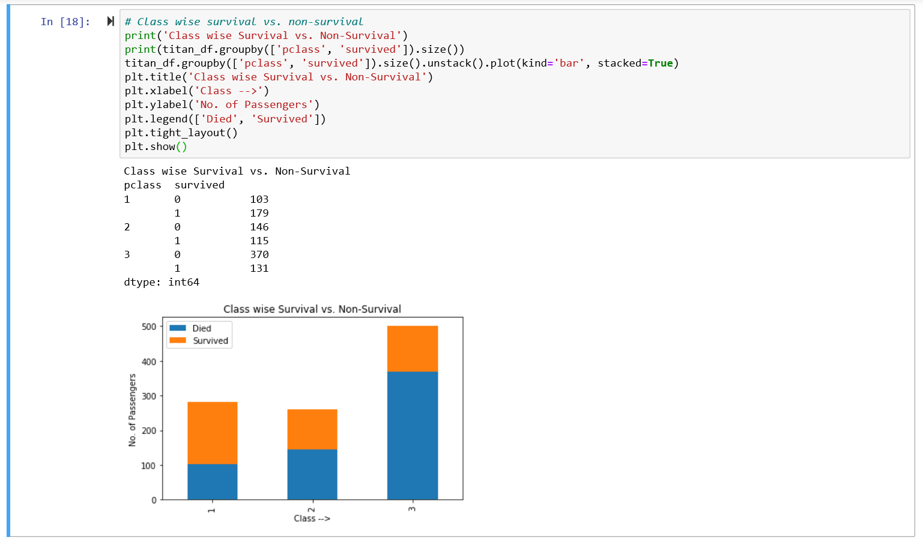
Class wise Survival v/s Non Survival

Slide 16
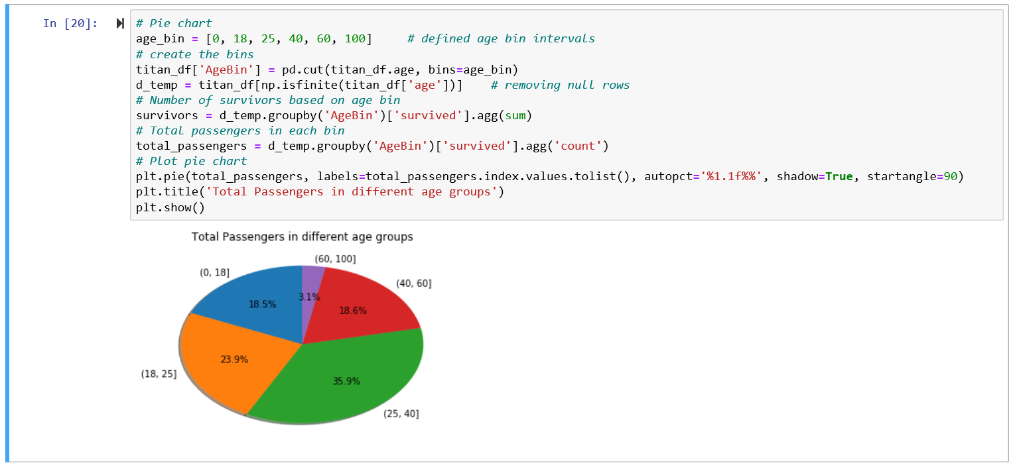
Pie Chart of Passengers Age Groups

Slide 17
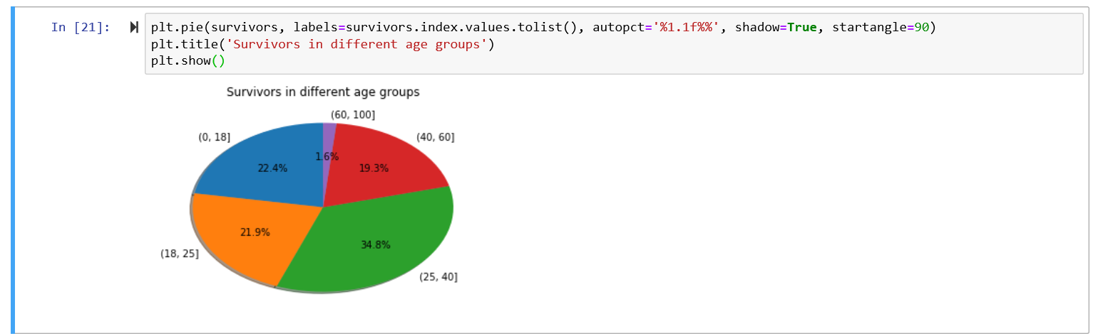
Pie Chart of Passengers in Different age Groups

Slide 18
Thank You
☻

